Slide 1
Company is Southwest Airlines
Student Name
Insti5tution Affiliation

Slide 2
Southwest Airlines Business Overview and Strategy
It is the largest low-cost carrier in the world with headquarters located in Dallas, Texas.
The purpose the company is to connect people to what’s important in their lives through friendly, reliable, and low-cost air travel (Purpose, Vision, Values, and Mission, 2019).
Its vision is to become the world's most loved, most flown, and most profitable airline (Purpose, Vision, Values, and Mission, 2019).
Its mission is dedication to the highest quality of customer service delivered with a sense of warm, friendliness, individual pride, and company spirit (Purpose, Vision, Values, and Mission, 2019).

Slide 3
Southwest Airlines Business Overview and Strategy Cout’d
Then company believes in a sustainable future in which there will be a precise balance between customers, employees, stakeholders, and other stakeholders.
The company has a robust route network that carries most passengers in the US.
A compelling brand appeal with an outstanding customer service and hospitality
Superior financial position with 46 consecutive years of profitability,

Slide 4
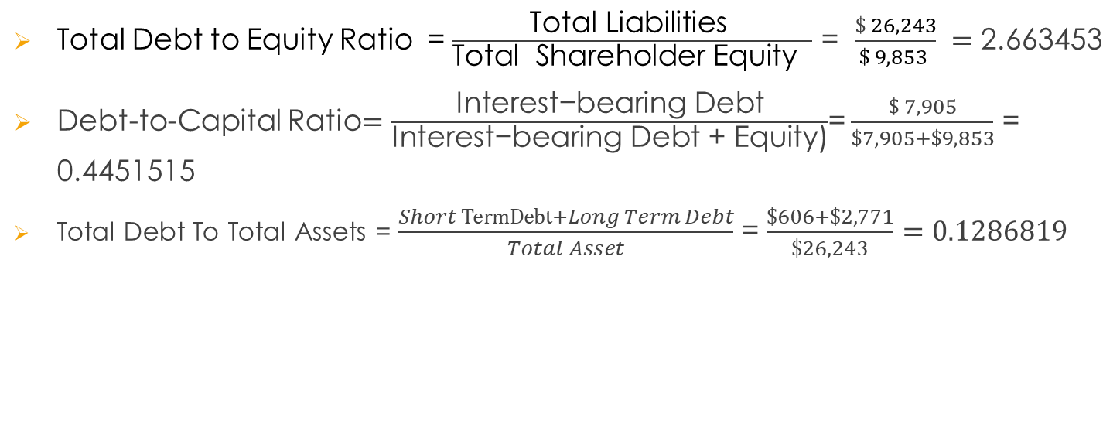
capital structure of Southwest Airlines
Total Debt to Equity Ratio = $\frac{\text{Total} \text{Liabilities} }{\text{Total} \text{Shareholder} \text{Equity} }$ = $\frac{\$ 26,243}{\$ 9,853 } =$ 2.663453
Debt-to-Capital Ratio$=\frac{\text{Interest}\text{−}\text{bearing} \text{Debt}}{\text{Interest}\text{−}\text{bearing} \text{Debt}\text{ + }\text{Equity}\text{)}}$= $\frac{\$ 7,905}{\$7,905+\$9,853}$ = 0.4451515
Total Debt To Total Assets = $\frac{Short TermDebt+Long Term Debt}{Total Asset}$ = $\frac{\$606+\$2,771}{\$26,243}=0.1286819$

Slide 5
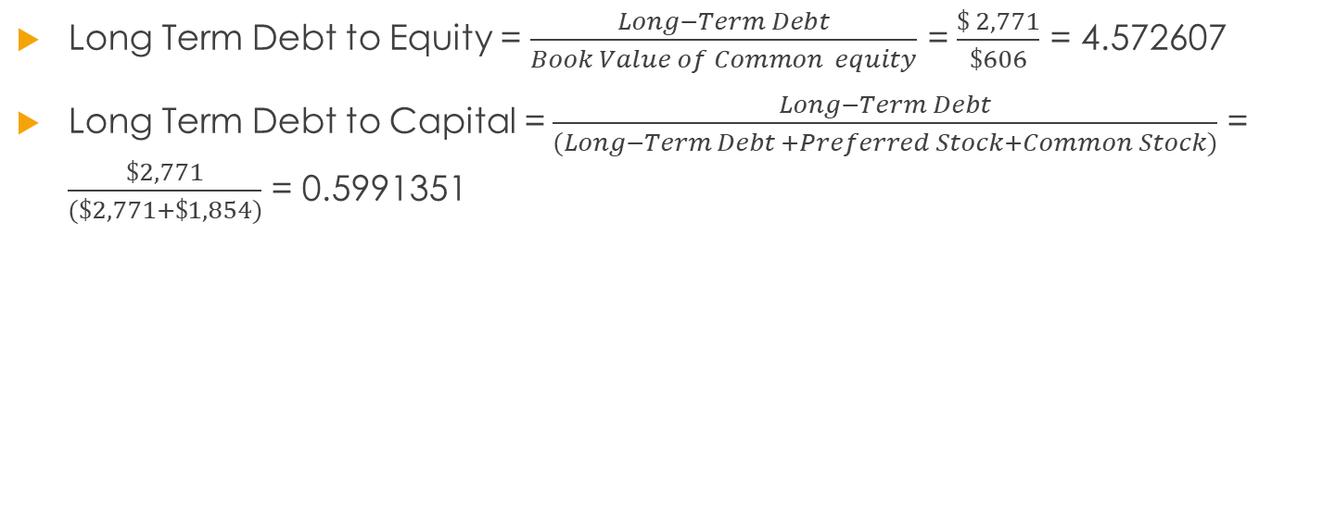
capital structure of Southwest Airlines
Long Term Debt to Equity = $\frac{Long−Term Debt}{Book Value of Common equity}$ = $\frac{\$ 2,771}{\$606}$ = 4.572607
Long Term Debt to Capital =$\frac{Long−Term Debt}{(Long−Term Debt +Preferred Stock+Common Stock)}$ = $\frac{\$2,771}{(\$2,771+\$1,854)}$ = 0.5991351

Slide 6
References
Southwest Airlines Co (LUV) 10K Annual Reports & 10Q SEC Filings | Last10K. (2019, February 5). Retrieved from https://last10k.com/sec-filings/luv#s33B13B8384B75C7384C1C7F26AF5ECE9
Purpose, Vision, Values, and Mission. (2019, 25). Retrieved from http://investors.southwest.com/our-company/purpose-vision-values-and-mission

